Slide 1
Iterate Yourself! Using Agile Methodologies to Build a Better You
David Buckingham
Notes:
Good afternoon!
I hope that everyone has had a good Code PaLOUsa.
If you see a conference organizer or volunteer, please be sure to thank them.
How many of you would call yourself active? Moderately active? Not active at all? I hope that there a little something here for everybody.
My apologies for the lame title. It feels hokie to me… Other possibilities included…

Slide 2
Alternative Session Titles
Agile+Fitness
Becoming Active the Agile Way
Hack Yourself!
Refactoring Yourself
EDD – Exercise Driven Development
FDD – Fitness Driven Development
ADD – Active Driven Development
Iterate Yourself! Using Agile Methodologies to Build a Better You

Slide 3
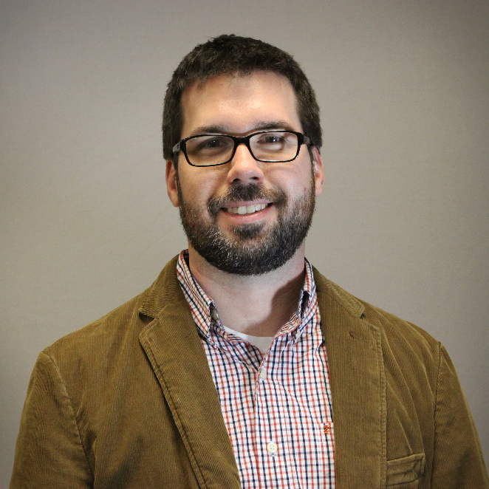
About Me
David Buckingham
Senior Consultant
KiZAN Technologies
david.buckingham@kizan.com
@davidbuckingham

Slide 4
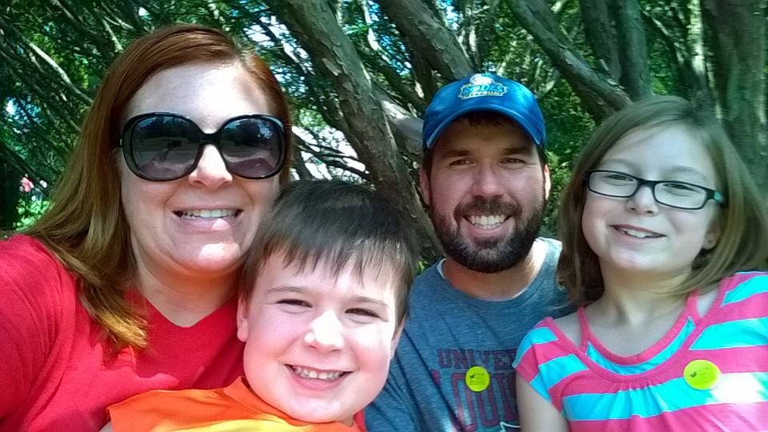
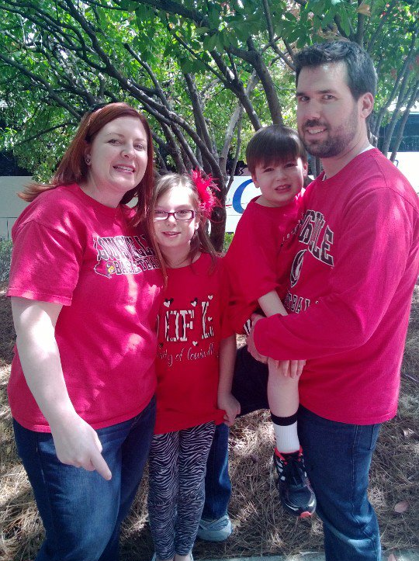
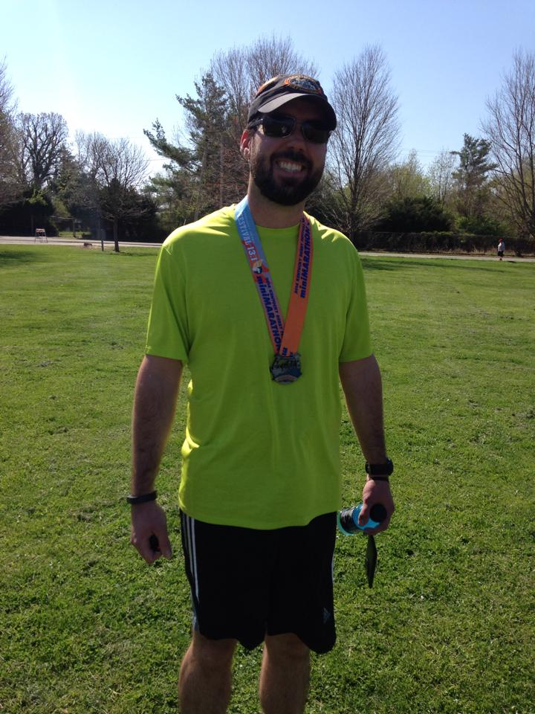
About Me
Husband & Father
Love Running
Diehard UofL Fan, GO CARDS!!!
Louisvillian, born-and-raised
Notes:
Yes, that says that I “love” running. The often told joke is that “my sport is your sports punishment” ☺ It is possible to learn to “love running”.

Slide 5
About Me
I am an IT professional who routinely sits at his desk, in meetings, etc. for 8+ hours every day.
I noticed that I was unable to keep up with my kids, even at their youngest age.
I knew that it was time to make a change.
Notes:
I sit during my commute to the office. I sit at my desk. I sit in meetings. I sit at lunch. I sit during my commute home. I sit at home. I sit, sit, sit all day long.
I was never an “active” individual, but as I grew older, it started to catch up to me. Technically overweight, I noticed that I could even play with my kids.
I don’t have a story to share about how, as an overweight software developer, I attended a bootcamp and lost a-gazillion pounds over night.

Slide 6
Now…
I started as a back-of-the-pack runner, trending towards the middle-of-the-pack in my age group.
I try to run two half marathons each year, and many other shorter distance races.
I am not a marathoner, Olympic sprinter, etc.
Notes:
When I started “running”, I was averaging 14:45 / mi. 15:00 / mi is walking. I was barely running.
My largest accomplishments to date include a 200-mile 12-man relay last October. This past Saturday I set a personal record in a 10-miler: 1:34:30 (9:27/mile) finishing in the top 30% of a field of more than 5,000 runners. Next month I hope to finish a HM in less than 2:15:00 which I have been chasing for 2 years now. I’m projecting 2:05:00.
I simply wanted to become more fit, and set a good example for my kids by leading an active lifestyle. I have “learned” to love running, and depend on it to be a more focused individual.

Slide 7
Why?
We’ve been told what we need to do, let’s focus on “how”.
Why do so many people have trouble developing a more active lifestyle?
Notes:
Why another health and wellness talk?
We know that we need to stand more, and sit less. We know that we need to move.
What are some reasons that we have trouble leading an active lifestyle?
In this talk, I want to focus on “how”. How can we become more active. Not just standing up from our desks each hour, but actually getting out and active with a purpose.

Slide 8
Disclaimer and Disclosures
I am not a medical doctor.
I am not a personal trainer.
I am not an elite athlete.
Notes:
Not really “fine print”, but too the point.
All of this information is based entirely on my experience.

Slide 9
Content and Tone
I am a runner, and while I will try to deliver this content in a way that is not specifically about running, it may at times be very runner-focused.
Notes:
How do you know someone is a runner? Wait, they’ll tell you!

Slide 10
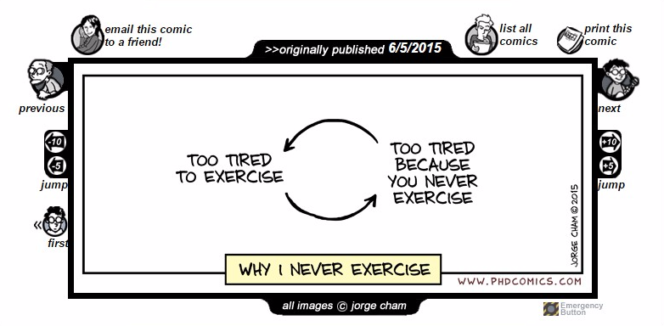
Notes:
Why is it that we do not exercise? Is it because we’re always too tired? Maybe we’re too tired because we never exercise. It’s a vicious cycle.
No time?
No idea how?

Slide 11
How many of you have tried to start a fitness plan, only to quickly fail?
Why is it that so many people fail or give up so quickly?
Notes:
How many people are from Louisville? There’s a little thing that happens on the first Saturday in May. A couple of people go to watch a horse race. This is after a 2 week party, which includes a half marathon and a full marathon. 43 years, 12K+ entrants, ranks among top 100 races by USA Track & Field. When I was younger, I supported my friends and family at many different racing events.
For years, I would “sit” along the route, bundled up to keep warm, with my coffee and donuts and would yell and scream words of support and encouragement.
Every year, without fail, I would tell myself “I could do this.”. So every year, I would try to start exercising. Sometimes I even made it outside of the house. I would tell myself “time to run”, and I would go for a run and become discouraged when I couldn’t “run”. Or I would fight through a week or two, only to stop because I got hurt, or lost interest, or it was too hard. I would begin to believe that maybe I just couldn’t “like” to exercise.
Most years, the idea simply died on the vine.

Slide 12
What changed?
Notes:
How did I go from all of those false starts, or not-starts, to leading a more active lifestyle?
In 2012 my daughter came home from school and said “I want to run cross country”.
I could have strangled her PE teacher! We asked, do you know what cross country is?
I decided that this was my chance. Thankfully we had some advance notice.
Couch to 5K – tears at mile 2. I’m actually doing this!
Daughter still runs to this day.
What was so different this time? What changed?
Sure, I’m older / wiser, was motivated to be a good role model for my children, but I also changed my approach. I simply just didn’t “start”, as I had before.

Slide 13
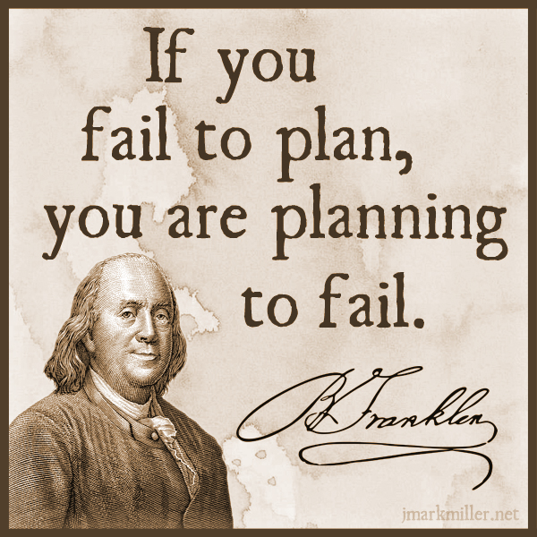
Notes:
I had a plan.
I used the Couch to 5K program. Now an app.
How many of you have heard of Couch to 5K? No, it doesn’t mean getting up off the couch and running a 5K.
This eased me into becoming more active.
I had support through social networking.
With the advent of smart phones, apps, and wearables, we’re seeing a resurgence of “activity”.

Slide 14
Until something becomes a “habit”, it’s simply just something we “have” to do.
Notes:
We perform tasks, to get stuff done. Only when an activity becomes routine, is it a habit. Once it’s a habit, we “must” do it, we “want” to do it. Until then we “have” to do it.
Becoming more active requires forming new habits. It’s not something that we can “just do”, and it certainly not developed overnight.

Slide 15
Bad Habits
Good Habits
Hard to Break
Easy to Break
Easy to Form
Hard to Form
Notes:
Good and Bad Habits are opposite. Duh.
More than opposite, they are also inverse.
Bad habits are hard to break: let’s take smoking for example. There are entire business plans formed about ways to help people quit smoking. Some are strong enough to just do it cold turkey, others try method after method, product after product, and still may never break the habit. Good habits, on the other hand, are easy to break. Flossing my teeth: good habit. I could easily just stop doing it. Who really enjoys flossing their teeth? Nobody.
Anyone can form a bad habit, that’s easy. My favorite snack food of choice is a bag of Doritos. Family Size Bag / Soon becomes a bad habit. / No real work on my part.
Good habits? They take work to form. And they’re not formed overnight. So why is it that we expect them to be?

Slide 16
How can we form good habits?

Slide 17
On average, it takes 9 weeks before a new behavior becomes automatic.
Notes:
In a 2009 study, Phillippa Lally of University College London concluded that it took, on average, 66 days or 9 weeks before a new behavior becomes automatic. In other words, a habit.
9 weeks. Hmm… When I see 9 weeks, I think to myself, that’s 3 sprints worth of work.
http://www.huffingtonpost.com/james-clear/forming-new-habits_b_5104807.html

Slide 18
To create a good habit, we need a plan.
Notes:
Not just “do stuff”, but an honest plan with measurables and goals. I’m not going to say “I need to run.” I need a workout plan so that I know exactly how I can get from A to B.
After completing my first 5K, I realized that I iteratively built up a new habit because I had a plan. I looked back on the plan that I used, the Couch to 5K, and realized something: I iteratively made changes to my workouts so that they became more and more intense. My body was adapting to the point where I didn’t even notice. Guess what? That plan was a 9 week plan.
Much like we iterate on features until they’re deliverable, I iterated on my health and wellness to complete my goals. Software isn’t developed overnight, so why was I expecting to become more active overnight?
Let’s use what we know about software development to plan and deliver a healthier lifestyle.

Slide 19
Agile Software Development
Notes:
We’ve all heard of Agile Software Development?
To summarize, Agile focuses on continuously delivering software, through iterations built upon collaboration with stakeholders and adapting to changing requirements.

Slide 20
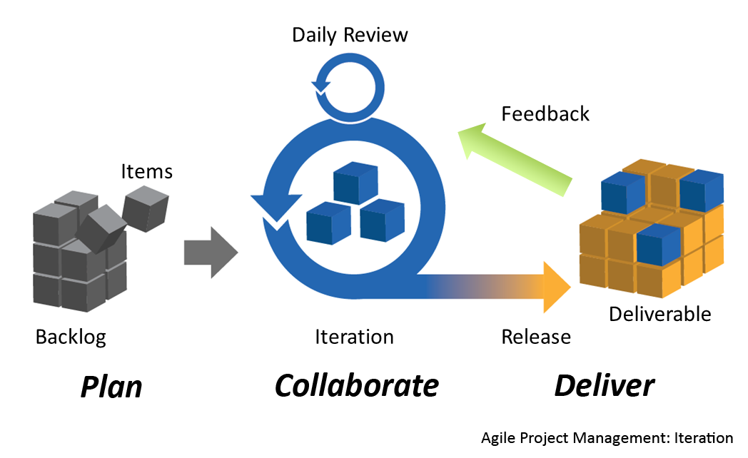
Agile Software Development
Notes:
It all starts with a backlog. A backlog is a group of work items which need to be completed.
Iterations are scheduled and work items are assigned. Throughout these iterations, we review our progress daily to better understand what we’ve completed, what is left to do, and are there any obstacles in our way.
Finally, at the end of an iteration, we release our deliverables and review the iteration during a retrospective.
Let’s see how we can apply some of these same terms, and others from software development, to building a new habit.

Slide 21
Feature
A feature is a defined outcome, or goal, which we want to deliver.
Notes:
“I want to run a 5K.”
“I want to ride for 25 miles.”
“I want to perform 100 pushups.”

Slide 22
User Story
A user story is a sentence, or two, describing how a feature or component should work.
Notes:
I like to think of user stories as my weekly plans.
“As an active individual, I will workout 3 days during week 1 so that I can remain active during the week.”
“As an active individual, I will schedule my workouts during my week to ensure that I am setup for success.”

Slide 23
Tasks
A task is a piece of work to be completed which supports a user story.
Notes:
A task is each individual workout.
5:00 warmup
1:00 run
1:30 walk
1:00 run
1:30 walk
Etc.
5:00 cooldown

Slide 24
Daily Standup
A daily meeting where we identify:
what did I do,
what do I plan to do,
are there any blockers?
Notes:
Daily Standup - "Plan" from Joe Kutner (youtube)
What did I do yesterday for my health?
What will I do today for my health?
Is there anything blocking me from being healthy?
Do something every day. Not necessarily the same activity, but make it a point to think about your health and wellness each day.
Plan new routines, stretches, new activities, etc.

Slide 25
Sprint 0
Notes:
“Before we get started”

Slide 26
Measurables & Tools
Notes:
Maybe I should call this measurable and tools.

Slide 27
“As an active individual, I want to visit a medical professional to have a biometric screening performed, so that I have a baseline.”
Notes:
Bear with me for a bit, as we review some “user stories” for a bit?
No one likes to hear “before starting any fitness program, visit your doctor to ensure that you are ready for physical activity”. But, we’re data driven individuals. Let’s use this to our advantage. Getting some baseline biometric data can help measure our success.
Becoming more active can have very direct results related to our biometrics. Getting a baseline will help us measure our progress.
Height, Weight, BMI, Waist, Blood Pressure, Cholesterol Panel, Glucose Screening
I had never realized this until the H&W program at a previous employer brought someone to the office to do the screenings for us, for free. I hadn’t been monitoring anything: I just wanted to be more active. I knew that I had lost some weight, but when the nurse took my blood pressure and cholesterol panel, she was amazed and acted as if I were out of the ordinary. “What do you do?”

Slide 28
“As an active individual, I want to perform a basic fitness test so that I have a baseline.”

Slide 29
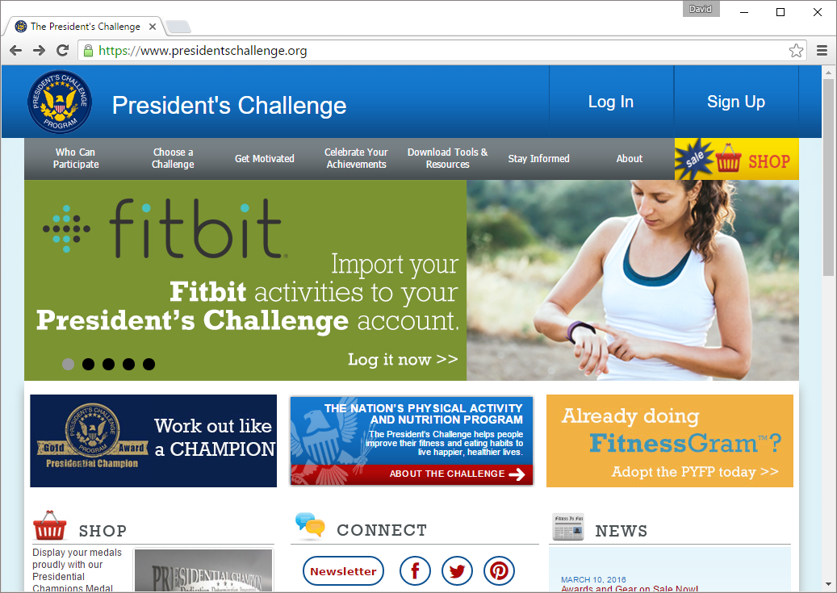
President’s Challenge
http://presidentschallenge.org
Notes:
Adult Fitness Test
Enter results for an evaluation
400-meter walk, 1-mile walk, 1.5-mile run
Half situps
Push-ups
Sit and reach

Slide 30

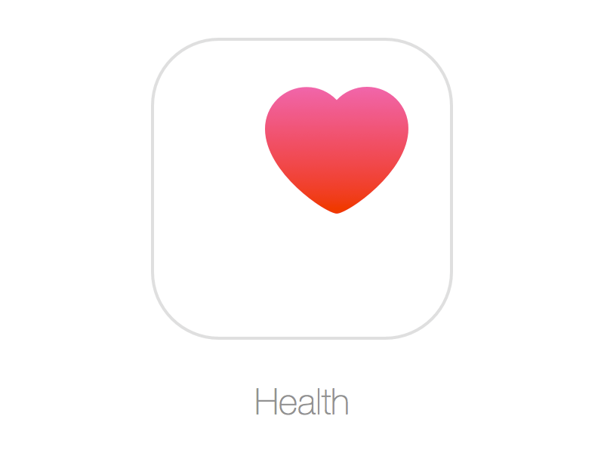
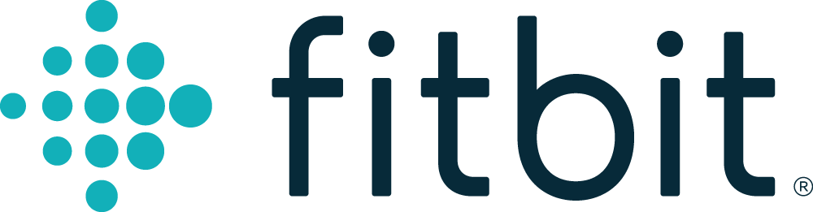


Fitness Trackers
Notes:
Fitness trackers “gamify” our activity. We can connect with one another, challenge one another, see how we rank against our friends, set goals, etc.
We are data driven individuals and also gadget fiends.
A common goal is to walk 10,000 steps / day.
Originated in Japan during the 1960s. Studies showed that the average person took 3,500 to 5,000 steps / day. If this were increased to 10K steps / day, we could burn roughly 20% of our caloric intake through activity. !0K steps is achievable, but in our society it definitely takes effort.
Do you know what 10K steps means? On a day in which I do not run, I may hit 2,000 steps per day. Even on a day that I run 3-3.5 miles in the morning, I struggle to hit 10K without a bit of extra effort in the evening.

Slide 31

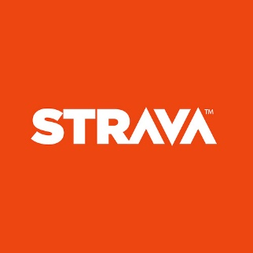



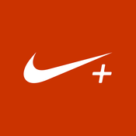

Find an App
Notes:
Some of these you may have seen, other you may not.
Fitocracy
Endomondo
RunningAhead
Strava
Changing apps, or ecosystems, can be hard. It’s not a wrong decision until you want to change.

Slide 32
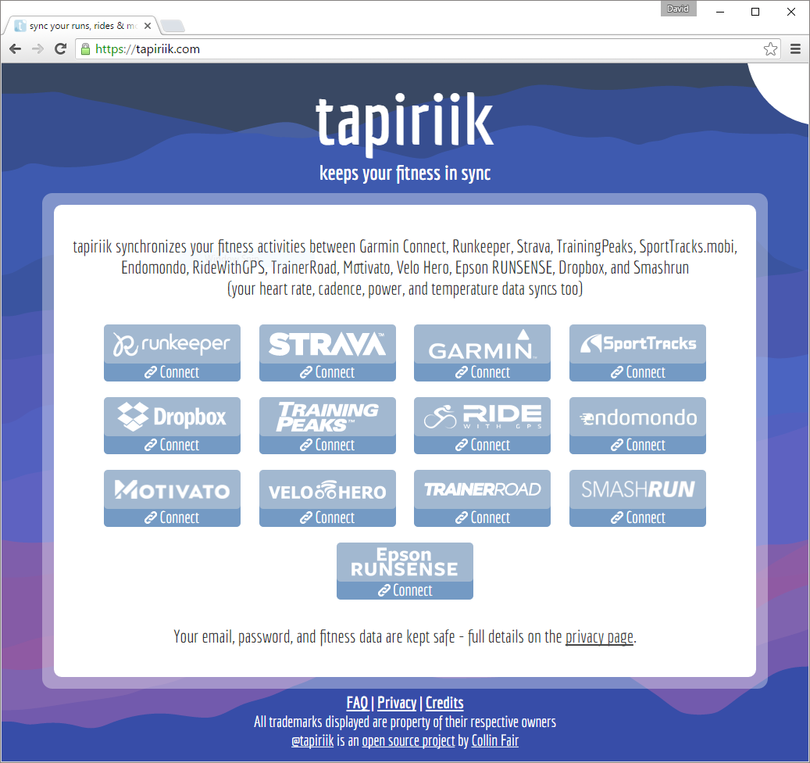
Tapiriik
https://tapiriik.com/
Notes:
Taprik is an interesting service which helps to connect these services or ecosystems so that data can be exchanged. It’s nice to move that data, but inevitably, it still takes some massaging.

Slide 33
Purchase gear for your activity of choice.
Notes:
Some will say that you should just start. Don’t sink a lot of money into a sport or activity that you do not think will stick.
Since running is my drug of choice, I’ll use it as an example: I started in poorly fitting shoes, which were passed their prime. I had joined a gym, thinking that this was the way to go. I thought that I was starting “easy” by simply using the ellipitical machine and didn’t exert a lot of energy in doing so. I just wanted to get use to the equipment. After 2 weeks my knees were killing me. I was only going 2-3 times each week, and only on the machine for 15 minutes.
I like having that “stuff” that’s just for working out. I can’t wear it unless I’m working out. It’s single purpose. Makes it a bit “special”.
“Pay” yourself to exercise.

Slide 34
Planning
Notes:
We’ve talked about measurable and tools. Let’s get into planning.

Slide 35

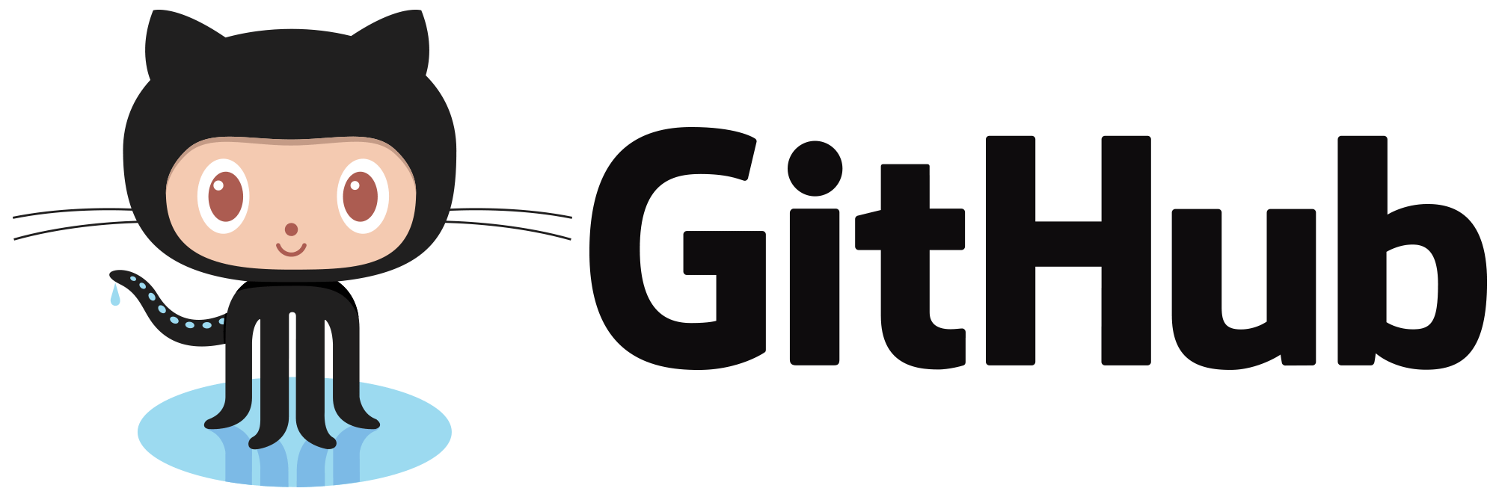


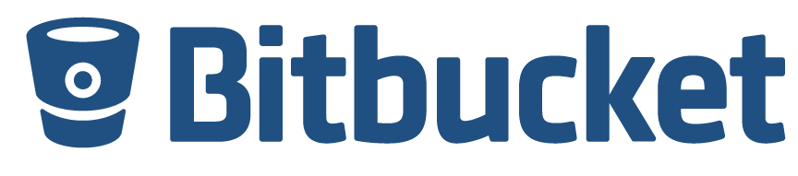
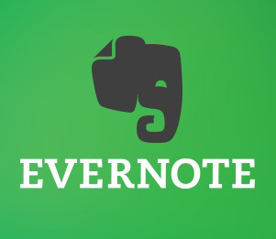

Building your Backlog
Notes:
As IT professionals, we like the idea of a backlog of work: we need to know what tasks are ahead of us, and what should be completed next. When trying to build a more active lifestyle: plan ahead. Don’t let yourself decide along the way. That leaves too much room for error. It’s not enough to say “tomorrow I’m going for a run”. Each workout should have a purpose. Building base miles? Easy run? Long run? Speed work? Hills? Tempo?
Obviously, you could use any ALM tool that you’re comfortable with, but honestly: make it simple. Excel, Evernote/OneNote, or simply a text file. If you feel that you’d be more likely to stick to your plan if you could use a tool like Visual Studio Team Services, GitHub, or Bitbucket, go ahead! But build a backlog of work.
How do we find this backlog of work?

Slide 36
Training Plans
Couch to 5K
Hal Higdon’s Training Plans
http://halhigdon.com
runDisney Training http://www.rundisney.com/training/running/
Notes:
All of these sources, and others have one thing in common: you will incrementally add intensity to reach your goal. All of these programs range from 9 – 18 weeks. Hmm… I bet that we can track our progress in sprints?

Slide 37
Programs
On Hundred Pushups
http://hundredpushups.com
30 Day Fitness Challenges
http://30dayfitnesschallenges.com
Notes:
Maybe you’re not into running.
There are programs for simple body weight exercises that can be done as well.
Let’s take a look at a sample training plan.

Slide 38
Week 1 Sample
Week | Workout 1 | Workout 2 | Workout 3
1 | 0:00 – 5:00 Warm Up Walk 5:00 – 6:00 Run 6:00 – 7:30 Walk 7:30 – 8:30 Run 8:30 – 10:00 Walk 10:00 – 11:00 Run 11:00 – 12:30 Walk 12:30 – 13:30 Run 13:30 – 15:00 Walk 15:00 – 16:00 Run 16:00 – 17:30 Walk 17:30 – 18:30 Run 18:30 – 20:00 Walk 20:00 – 21:00 Run 21:00 – 22:30 Walk 22:30 – 23:30 Run 23:30 – 25:00 Walk 25:00 – 30:00 Cooldown Walk | 0:00 – 5:00 Warm Up Walk 5:00 – 6:00 Run 6:00 – 7:30 Walk 7:30 – 8:30 Run 8:30 – 10:00 Walk 10:00 – 11:00 Run 11:00 – 12:30 Walk 12:30 – 13:30 Run 13:30 – 15:00 Walk 15:00 – 16:00 Run 16:00 – 17:30 Walk 17:30 – 18:30 Run 18:30 – 20:00 Walk 20:00 – 21:00 Run 21:00 – 22:30 Walk 22:30 – 23:30 Run 23:30 – 25:00 Walk 25:00 – 30:00 Cooldown Walk | 0:00 – 5:00 Warm Up Walk 5:00 – 6:00 Run 6:00 – 7:30 Walk 7:30 – 8:30 Run 8:30 – 10:00 Walk 10:00 – 11:00 Run 11:00 – 12:30 Walk 12:30 – 13:30 Run 13:30 – 15:00 Walk 15:00 – 16:00 Run 16:00 – 17:30 Walk 17:30 – 18:30 Run 18:30 – 20:00 Walk 20:00 – 21:00 Run 21:00 – 22:30 Walk 22:30 – 23:30 Run 23:30 – 25:00 Walk 25:00 – 30:00 Cooldown Walk
Notes:
There are taken from the Couch to 5K plan that I used.
At the time, when I was asked if I ran, I answered “I do not run, I shuffle”. Speed does not matter. Just try not too walk.
1 minute run, following my a 1.5 minute recovery walk. This first run, I was winded. I couldn’t run for 1 minute. I hurt near the end.

Slide 39
Week 2 Sample
Week | Workout 1 | Workout 2 | Workout 3
2 | 0:00 – 5:00 Warm Up Walk 5:00 – 6:30 Run 6:30 – 8:30 Walk 8:30 – 10:00 Run 10:00 – 12:00 Walk 12:00 – 13:30 Run 13:30 – 15:30 Walk 15:30 – 17:00 Run 17:00 – 19:00 Walk 19:00 – 20:30 Run 20:30 – 22:30 Walk 22:30 – 24:00 Run 24:00 – 26:00 Walk 26:00 – 30:00 Cooldown Walk | 0:00 – 5:00 Warm Up Walk 5:00 – 6:30 Run 6:30 – 8:30 Walk 8:30 – 10:00 Run 10:00 – 12:00 Walk 12:00 – 13:30 Run 13:30 – 15:30 Walk 15:30 – 17:00 Run 17:00 – 19:00 Walk 19:00 – 20:30 Run 20:30 – 22:30 Walk 22:30 – 24:00 Run 24:00 – 26:00 Walk 26:00 – 30:00 Cooldown Walk | 0:00 – 5:00 Warm Up Walk 5:00 – 6:30 Run 6:30 – 8:30 Walk 8:30 – 10:00 Run 10:00 – 12:00 Walk 12:00 – 13:30 Run 13:30 – 15:30 Walk 15:30 – 17:00 Run 17:00 – 19:00 Walk 19:00 – 20:30 Run 20:30 – 22:30 Walk 22:30 – 24:00 Run 24:00 – 26:00 Walk 26:00 – 30:00 Cooldown Walk
Notes:
Looks similar, but look closely:
1.5 minute run, 2 minute walk.
Slightly more running, but followed my slighting more recovery.
Let’s jump ahead a bit

Slide 40
Week 5 Sample
Week | Workout 1 | Workout 2 | Workout 3
5 | 0:00 – 5:00 Warm Up Walk 5:00 – 10:00 Run 10:00 – 13:00 Walk 13:00 – 18:00 Run 18:00 – 21:00 Walk 21:00 – 26:00 Run 26:00 – 30:00 Cooldown Walk | 0:00 – 5:00 Warm Up Walk 5:00 – 13:00 Run 13:00 – 18:00 Walk 18:00 – 26:00 Run 26:00 – 30:00 Cooldown Walk | 0:00 – 5:00 Warm Up Walk 5:00 – 25:00 Run 25:00 – 30:00 Cooldown Walk
Notes:
In week 5 the workouts start to differ a bit. We’ve grown accustomed to more running, or have we?
5 minute run, 3 minute walk
8 minute run, 5 minute walk
20 minute run!?!?!?
W5D3 was circled on my calendar.

Slide 41
Week 9 Sample
Week | Workout 1 | Workout 2 | Workout 3
9 | 0:00 – 5:00 Warm Up Walk 5:00 – 35:00 Run 35:00 – 40:00 Cooldown Walk | 0:00 – 5:00 Warm Up Walk 5:00 – 35:00 Run 35:00 – 40:00 Cooldown Walk | 0:00 – 5:00 Warm Up Walk 5:00 – 35:00 Run 35:00 – 40:00 Cooldown Walk
Notes:
30 minute run

Slide 42
Scheduling
Notes:
This is all well and good, but when? I don’t have the time?

Slide 43
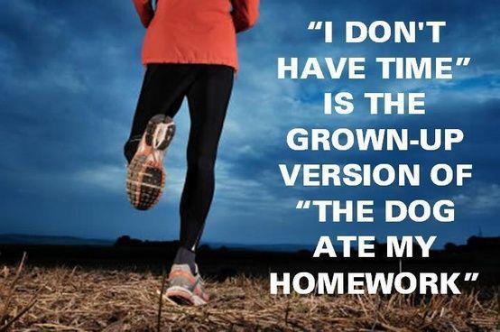
Notes:
“I don’t have time.” Is easy to say. I still say it.
“I don’t have time” really means “I can’t make time”. Let’s learn how we can creatively make time to set ourselves up for success.

Slide 44
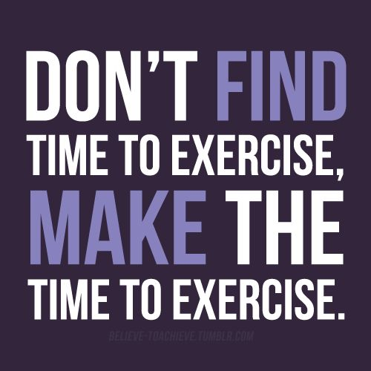

Slide 45
Schedule your workouts for the week.
Notes:
We often let others control OUR calendar. “Send me a meeting invite.” “Put it on my calendar.” are often heard around the office. Protect your calendar! Put your workout on the calendar and protect it.
It’s difficult to find the same time each day to do our workouts. Try to find the best time for you, throughout the week. It takes a bit of planning, but can easily be done. This should be a “task” each week during our sprints.

Slide 46
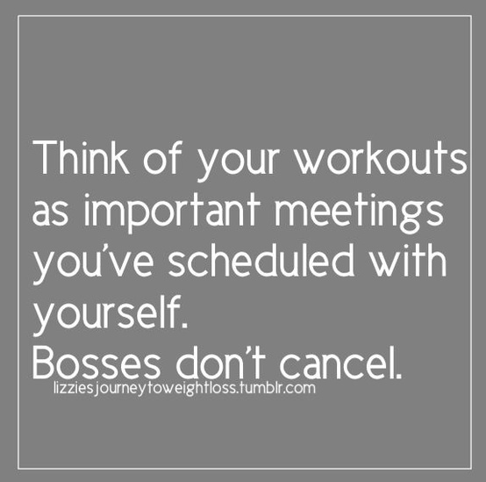

Slide 47
There are 3 times of day to workout:
Morning
Lunch
Evening
Notes:
Duh? Thank you master of the obvious.
Ease into morning workouts. If we’re forcing ourselves out of bed early every morning, it’s not likely that our workouts will become routine or habits.
We’re trying to change something already: becoming more active. I’d suggest not trying to make too many changes at once.
I started by sneaking out at lunch, or scheduling time in the evenings. It’s easy for me during XC season.
When I need to start running more frequently, I decided I had to become a morning runner.
Be careful about working out too late into the evening. Workouts tend to “rev the engine” which may lead to trouble getting to sleep.

Slide 48
Plan the night before.
Notes:
I check the weather. If it’s not going to rain or snow, and the temperature is 20deg or higher, I’m going running. It was previously 30deg until I got some cold weather base layers.
Set out clothes, set alarms.
By doing this the night before, I’ve already told my mind when the alarm goes off that “it’s time to get up and workout”.
I suggest adopting this routine or attitude only after the hook has been set.
It’s still very easy to try and stay in bed. Once your workouts have become habits, it’s much easier to get up.
Find ways to set yourself up for success. When is the best time for you? Keep in mind that it might be different each day.

Slide 49
Support and Maintenance

Slide 50
You have completed your goal, congratulations!
Notes:
But what’s next?

Slide 51
Recovery: very important, but do not let your momentum slip!
Notes:
Continue to block off time, walk instead of run. Light cycling. Keep moving, just to stay loose and fluid. Continue dedicating that time to yourself so you do not lose your fitness, or your habits.

Slide 52
Define a new goal:
Faster 5K, longer distance (10K),
longer planks, more pushups, etc.
Notes:
Define a new goal, and start building your backlog again.

Slide 53
Closeout

Slide 54
Retrospective
Reassess Biometric Screening
Revisit Fitness Test
Notes:
Have we made any improvements?
You most likely “feel” better, but what about the direct benefits that we spoke about earlier? Have we made any improvements in our waist line? Blood pressure?
What about our basic fitness levels? Can we do more pushups? Situps? How fast can we run 1-mile?

Slide 55
Indirect Benefits
Jumpstarting your Day
Better Focus / Clearer Mind
Daily Reflection
Notes:
We’ve discussed Direct Benefits: biometric screenings, improved fitness metrics, etc.
What about the indirect benefits. Exercising in the morning jumpstarts your day: the engine is rev’d and ready. Middle of the day? Resets your day and clears your mind. In the evening? Daily reflection. What did you accomplish, what’s let to get started tomorrow.

Slide 56
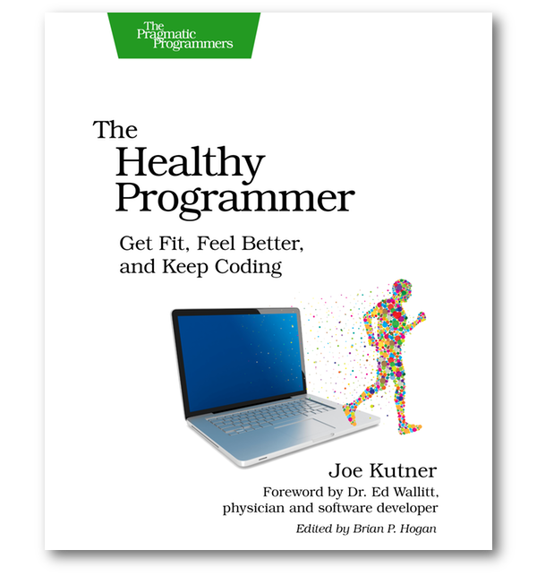
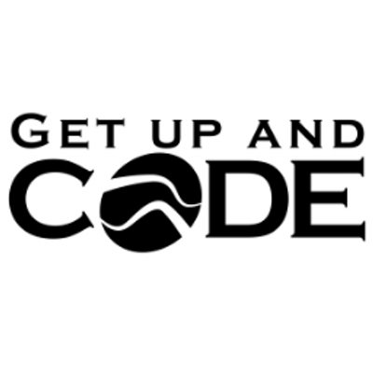
Resources
“Healthy Programmer”
Joe Kutner
http://healthyprog.com
“Get up and Code” Podcast
John Sonmez, et. al.
http://getupandcode.com

Slide 57
Closing
Forming new habits takes time.
Build a backlog.
Define measurables so that we can track progress.
Creatively schedule for success.

Slide 58
Thank you!
David Buckingham
Senior Consultant
KiZAN Technologies
david.buckingham@kizan.com
@davidbuckingham
Notes:
Questions?
Where are you in your journey?
Just getting started?
Well on your way and looking to improve?
A seasoned professional always looking for new ideas?
Tweet at me or e-mail me.

